Slide 1
picoScan100
Compact in size! | Big in performance! | Cost efficient in price!
Customer
picoScan100
Version 2.0

Slide 2
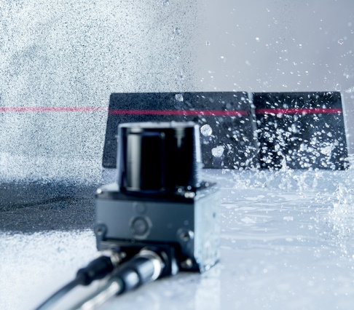
PRODUCT DESCRIPTION
A short description of the picoScan100
The picoScan100 is a compact 2D LiDAR sensor with a size of a TiM and superior performance
More than a successor of TiM: the performance emphasizes the picoScan to even cover LMS1xx applications and to solve new solutions
picoScan150 with 3 main performance packages:
Core | Prime | Pro
picoScan120 for indoor streaming applications
Software defined product with various software options and features to individual solve customers’ needs
High robustness in hardware & software allows to solve even harsh outdoor applications
Uses a System Plug concept for a customized connectivity to emphasize an easy integration into customers system environment or interfaces
Measurement data streaming and 2D Object Detection

Slide 3


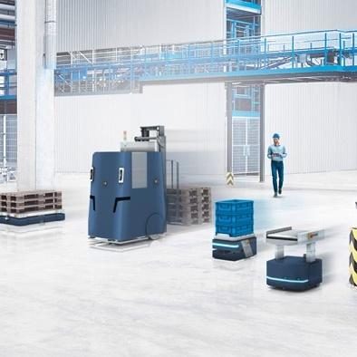
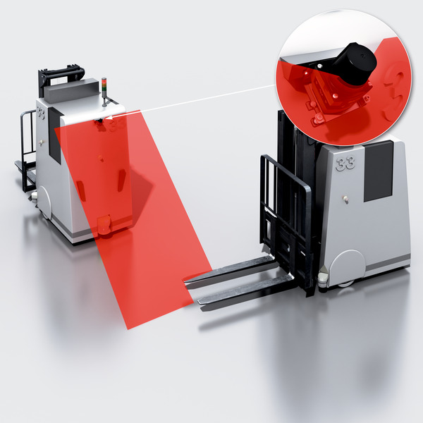
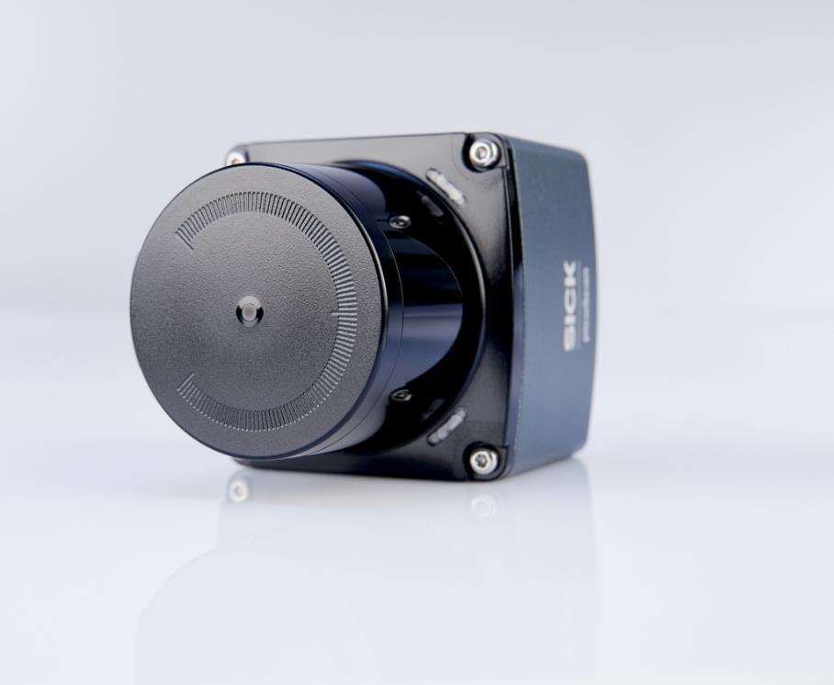
PRODUCT DESCRIPTION
Strategic approach – One product for many applications
    The picoScan100 reliably enables higher speeds, more precise localization, and highly efficient processes for almost every applications. No matter which industry:
    Intralogistics integrators, Robotic companies and AMR companies
    Classical manufacturers of mobile platforms (AGVs, forklift trucks, order pickers...)
    EMS companies (Electronics Manufacturing Services)
    Outdoor Automation integrators
    All industrial companies automating their processes

Slide 4











PRODUCT DESCRIPTION
picoScan150 highlights
Sensing performance that percepts the environment
Wide sensing range up to:
  120 m on reflectors
  75 m @90% remission, 10 klx
  40 m @10% remission, 10 klx
Up to 50 Hz scanning frequency
High angular resolution of 0.05°… 1°
Huge field of view of 276°
Powerful HW and algorithms
MPSoC (multi-processing System-on-Chip)
Multi-Echo evaluation
Intelligent filters
Improved diagnostics
Headless firmware updates
{REST API}
High quality measurement data
Statistical error (σ) typ.:
  ≤ 2 mm (0.05 … 5 m), ≤ 16 mm (5 … 60 m)
±1° scan field flatness
Beam divergency of typ. 0.27° / 4.8 mrad
Segmented data output (30° / 60°) for lowest latencies
Reflector Detection
API and drivers
State of the art REST API interface & drivers
Fast integration with code examples
Efficient & low latency data transmission
Native ROS2 for seamless integration
Choice of connectivity options
M12 connectors or cable versions
Ethernet, configurable I/Os, CAN**
Encoder input**
Dynamic Sensing Profiles
Adaption of measurement core parameters
Dynamic adaption to sub-tasks during operation
“One fit’s all” sensor: from very accurate close-range tasks to wide-range navigation tasks
Flexible Software concept
SOPASair Webserver
Choice of Sensor Apps:
  Data Streaming
  2D Object Detection
  LiDAR-LOC
  Drive Assist System (DAS)
Optional software features
Ruggedized performance
Interference suppression
Shock & vibration resistance
100 klx Ambient light immunity
** future options

Slide 5

PRODUCT DESCRIPTION
picoScan120 highlights
Software, API and drivers
State of the art REST API interface & drivers
Fast integration with code examples
Efficient & low latency data transmission
Headless firmware update
{REST API}
Sensing performance that percepts the environment
Wide sensing range up to:
  30 m on reflectors
  30 m @90% remission
  18 m @10% remission
20 Hz scanning frequency
High angular resolution of 0.1°
Huge field of view of 276°
Connectivity
1 x “Ethernet” connection, 4-pin M12 female connector (0.25m), D-coded
1 x “Power” connection, 5-pin M12 male connector (0.35m), A-coded
High quality measurement data
Statistical error (σ) typ.:
  ≤ 5 mm (0.05 … 5 m)
  ≤ 20 mm (5 … 30 m)
Typ. ±1° scan field flatness
Segmented data output (30°) for lowest latencies
Reflector Detection
Compact Indoor design
Pigtail for less integration space
IP65 (IEC 60529:1989+AMD1:1999+AMD2:2013)
Shock & vibration resistance
80 klx Ambient light immunity
-10 °C ... +50 °C (-14°F…122°F)

Slide 6
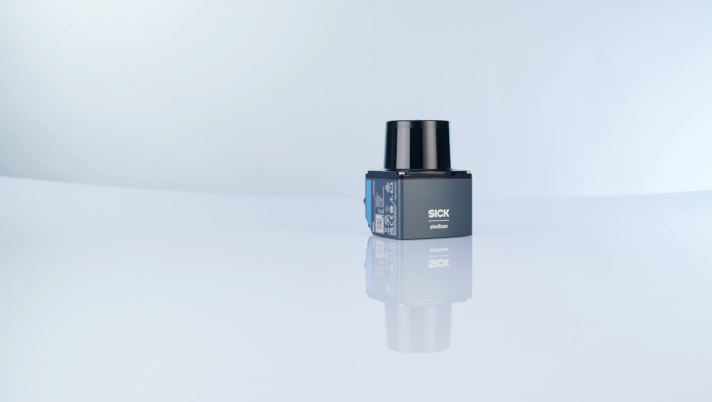

TECHNICAL DETAILS
  Sensing performance
 | picoScan120 | picoScan150 Core | picoScan150 Prime | picoScan150 Pro
Working range maximum* | 0.05 … 30 m | 0.05 … 25 m | 0.05 … 60 m | 0.05 … 120 m
Working range typ. at 90 %* | 30 m | 25 m | 47 m | 75 m
Working range typ. at 10 %* | 18 m | 12 m | 25 m | 40 m
Angular resolution | 0.10° | 0.25° @ 25 Hz 0.33° @ 15 Hz 1.00° @ 15 Hz | 0.10° @ 20 Hz 0.25° @ 40 Hz 1.00° @ 15 Hz | 0.05 … 1.00°
Scan frequency | 20 Hz | 15..50 Hz | 15..50 Hz | 15 ... 50 Hz
Sensor Apps | Data Streaming (only) | Optional | Optional | Included
Software Features & Packages | Defined | Optional | Optional | Included
* Indoor & varies by configuration of scanning frequency and ang. resolution

Slide 7
PRODUCT DESCRIPTION
  Sensor apps and software functions
 |  | picoScan120 | picoScan150 Core | picoScan150 Prime | picoScan150 Pro
Sensor Apps | Streaming | ■ | □ | □ | ■
 | 2D Object Detection (Advanced) | - | □ | □ | ■
Software Functions | Dynamic Sensing Profiles Package | - | - | □ | ■
 | Multi-Echo Technology | - | □ | □ | ■
 | IMU (Inertial Measurement Unit) | - | □ | □ | ■
 | Reflector Detection | ■ | □ | □ | ■
 | PTP (Precision Time Protocol) | - | □ | □ | ■
 | Data Reduction & Preparation Filter Package | Particle filter only | □ | □ | ■
 | Reliability Package | - | □ | □ | ■
 | Native ROS2 | - | □ | □ | ■
 | LMDscandata | ■ | □ | □ | □
 |  |  | - not available | □ optional – extra charge | ■ included – no extra charge

Slide 8


FEATURES AND BENEFITS
2D Object Detection Highlights
Field evaluation with island fields
2D Object Detection
  Outstanding sensing performance + 2D Object Detection
  = New possibilities
Field infringement logging
Support of Ethernet telegrams
Simultaneous evaluation of min. 10 fields
Easy to use

Slide 9
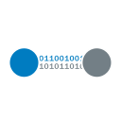
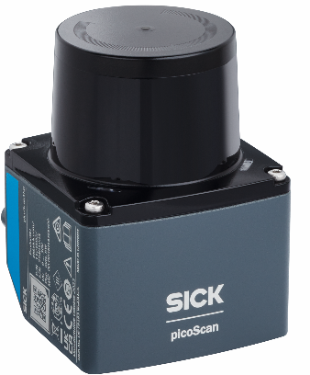






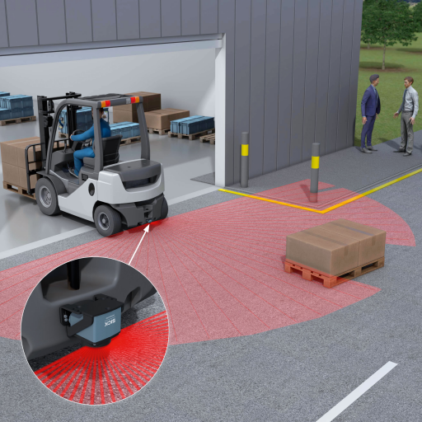
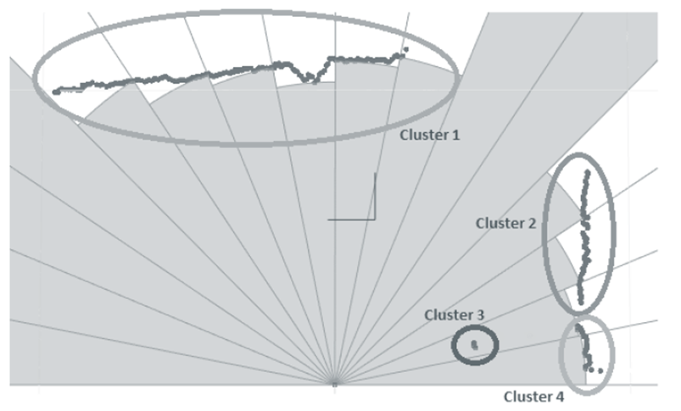
FEATURES AND BENEFITS
Operator Assist System based on picoScan150
  The challenge of driver assistance for industrial trucks
    Use of high-resolution, robust LiDAR data that detects even smallest objects
    Use of "native" vehicle communication
      CANopen
      Good robustness and standard, limited bandwidth
  Solution: LiDAR with Software skills 😉
  Integration of high-precision LiDAR data
  into a CANopen vehicle system
⚡

Slide 10
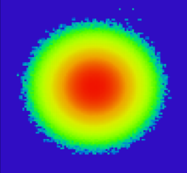



FEATURES AND BENEFITS
Measurement data streaming for mobile platforms
FEATURES
BENEFITS
Enhanced sensing capabilities
Up to 75 m @ 90% | up to 0.05°
detection of small objects or fine patterns
accurate localization
reliable collision avoidance
Rapid data output and time synchronization
Up to 50 Hz | segmented Data output | NTP / PTP
optimized latencies
high data quality
reduces time blurring effects
Dynamic Sensing Profiles
Adaptation of the measuring core parameters
dynamic adaption to changing requirements of sub-tasks within one application
HDDM+ multi pulse technology
gap-free scanning
mutual interference resistance
Eases usage in large mobile robot fleets

Slide 11




FEATURES AND BENEFITS
Measurement data streaming for mobile platforms
FEATURES
BENEFITS
High accuracies in all dimensions
Planarity ±1° | statistical error ≤ 2 mm | angular error ≤ 0.025°
less compensation is required in localization algorithms
more precise positioning
reduced alignment effort
Reflector Detection
Measurement value tagged with reflector flag
easy to distinguish between natural targets and reflectors
Selection of drivers, data formats, parameterization options and code samples
fast and efficient integration into the overall system
{REST API}
Wide field of view of 276°
270° + 6° extra
simplified 360° detection area installation with two sensors
Failure forgiving mounting for less adjustment effort

Slide 12




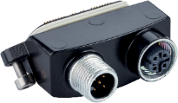
FEATURES AND BENEFITS
Outdoor capabilities
  Features enabling outdoor use
    Improved performance enables usage in wider areas
    Filter & analytics features
      Multi-echo – robust measuring data (dust, rain etc.)
      Fog suppression
      Reflector landmarks
      Optic hood contamination indication
  Ruggedized design
    Inbuilt Shock & Vibration resistance according to level:
      “advanced 1”: reduced availability at low scanning frequencies
      “advanced 2”: measurement function not guaranteed
    Dirt-repellent design
    Anticorrosive coating / painting
    Venting element
  Ambient conditions
    Temperature range: -33 °C…+50°C (-27.4°F…122°F)
    Ambient light immunity: 100 klx
    Ingress Protection: IP67 & IP65
    Robust performance in changing ambient conditions supported by venting element (GORE membrane)
  Connectivity and accessories for outdoor use
    Outdoor System plugs
      IP rated connectors
      Interfaces used in outdoor applications (CAN**)
    Accessories
      Weather hood, Outdoor cables
** future options

Slide 13
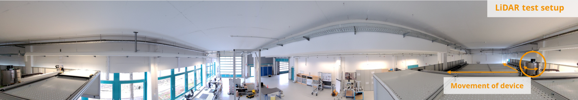
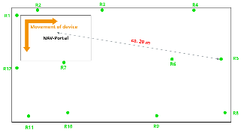
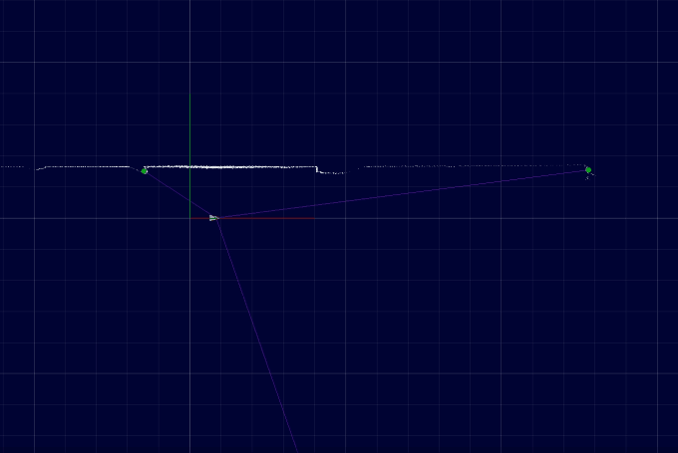
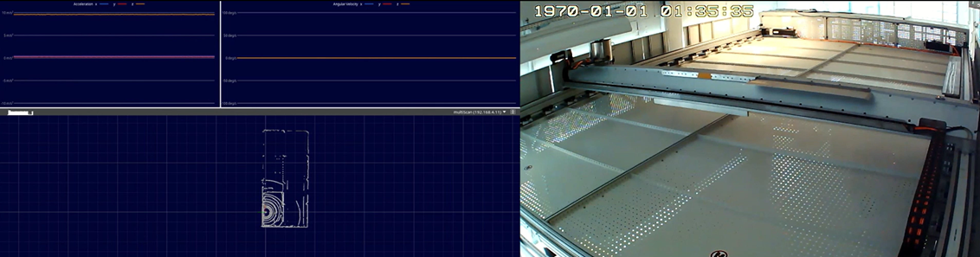
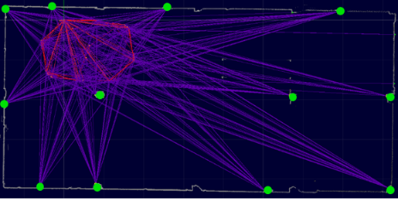
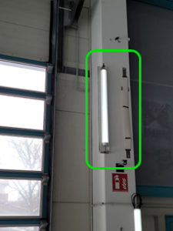
FEATURES AND BENEFITS
Technology Center Hamburg: excellent measurement accuracy tested!
picoScan100 and multiScan100 were tested on SICKs own Navigation Portal.
Overall, excellent sensing performance, very reliable reflector detection and low measurement noise. The reflector position accuracy showed a very good result with approx. 20 … 30 mm out of the box.

Slide 14

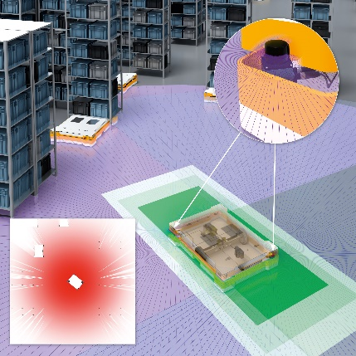
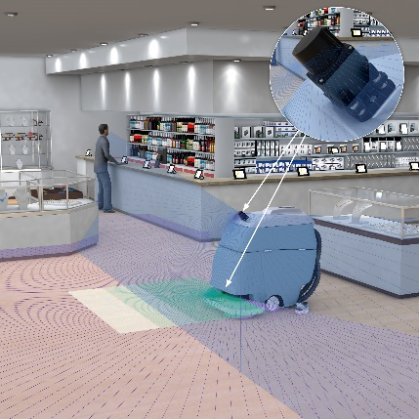
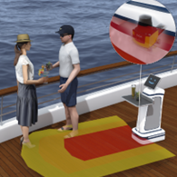
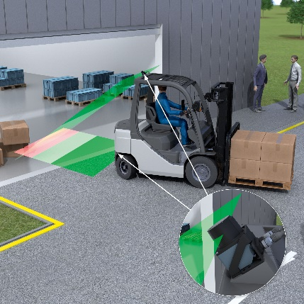
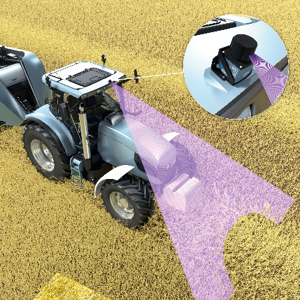

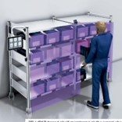
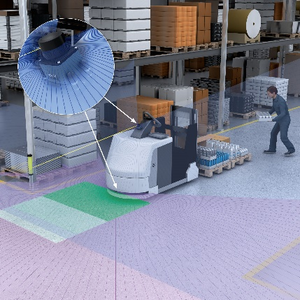
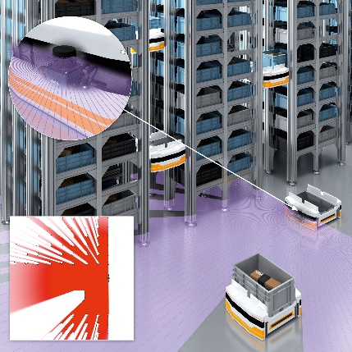
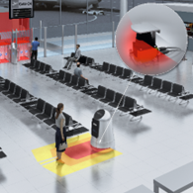
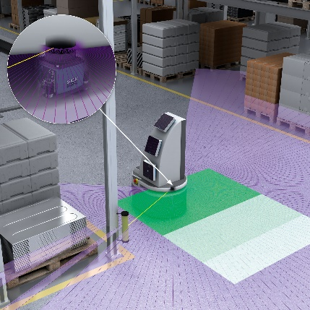
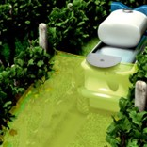
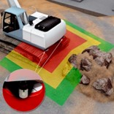
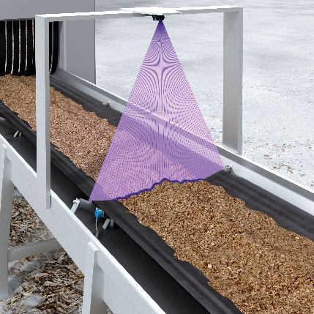
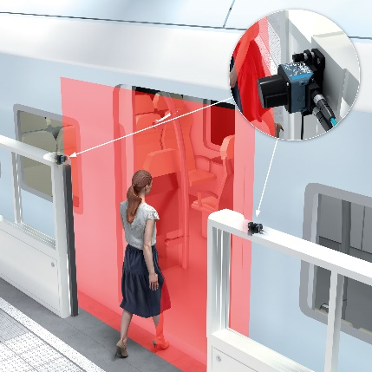
TARGET APPLICATIONS AND INDUSTIRES
Overview of target applications
  Industrial Mobile Platforms
    Industrial trucks
    AMRs (Autonomous Mobile Robots)
    Order picker
    AGCs (Automated Guided Carts)
  Commercial Mobile Platforms
    Cleaning Robots
    Serving Robots
    Assistance Robots
    Inventory Robots
  Mobile Outdoor Applications
    Forklift trucks
    Outdoor AMRs
    Agricultural vehicles
    Construction machines
  Stationary & other Applications
    Building security
    Logistics automation
    Mobility & outdoor automation
    Smart infrastructure

Slide 15
Thank you for your attention!
picoScan100

